Slide 1
Introduction to Computing
Lecture 3: Data Storage

Slide 2
Objective
After studying this chapter, the student should be able to:
List five different data types used in a computer
Describe how different data is stored inside the computer
Number, text, audio, video

Slide 3
DATA TYPES
Notes:
Các hệ số

Slide 4
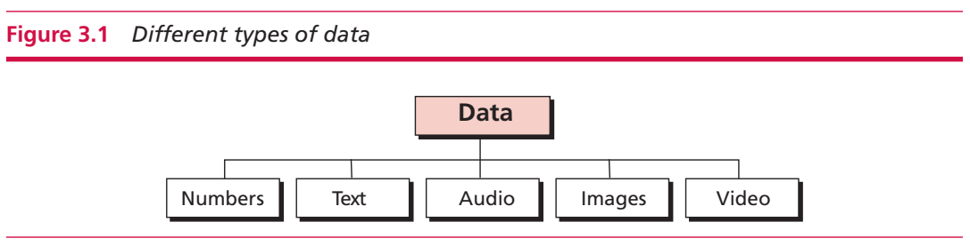
Introduction
DATA TYPES
Come in different forms including numbers, text, audio, images, and video
Notes:
Hệ đếm theo vị trí của ký số (Positional number system)

Slide 5
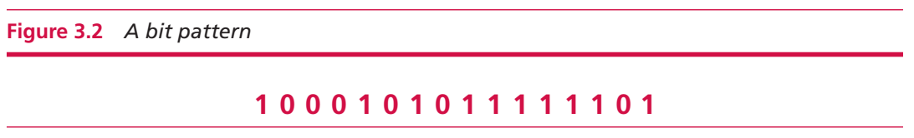
Data inside the computer
A bit (binary digit) is the smallest unit of data that can be stored in a computer and has a value of 0 or 1.
A bit represents the state of a device that can take one of two states.
Bit pattern is used to present different data types. It is a sequence, or as it is sometimes called, a string of bits
[object File]

Slide 6
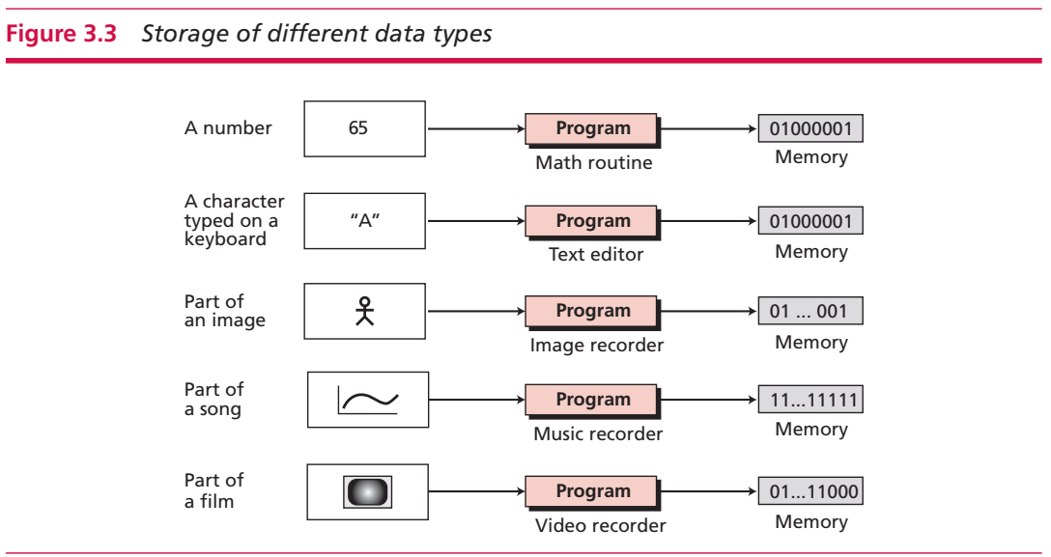
Storage of different data types
Notes:
Số nguyên
Không có phần thập phân

Slide 7
Storing integer numbers
Notes:
Các hệ số

Slide 8
STORING NUMBERS
A number is changed to the binary system before being stored in the computer memory.
There are still two issues that need to be handled: 1. How to store the sign of the number. 2. How to show the decimal point.

Slide 9
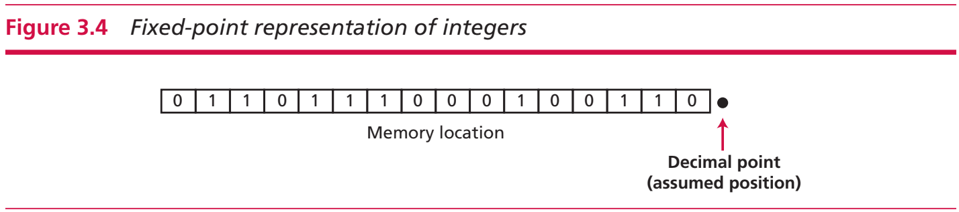
Storing integers
An integer can be thought of as a number in which the position of the decimal point is fixed: the decimal point is to the right of the least significant (rightmost) bit.
For this reason, f﻿ixed-point representation is used to store an integer.

Slide 10
Unsigned representation
An unsigned (không dấu) integer is an integer that can never be negative (âm) and can take only 0 or positive (dương) values.
Maximum unsigned integer, which has the value of (2^n - 1) where n is the number of bits allocated to represent an unsigned integer.

Slide 11
Storing unsigned integers
The integer is changed to binary.
If the number of bits is less than n, 0s are added to the left of the binary integer so that there is a total of n bits.
If the number of bits is greater than n, the integer cannot be stored (overflow)

Slide 12
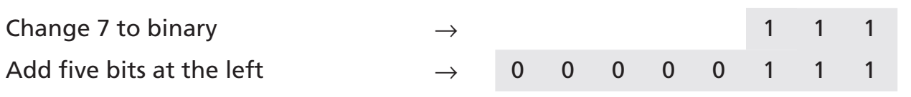
Example
Store 7 in an 8-bit memory location using unsigned representation.
Store 258 in a 16-bit memory location.

Slide 13
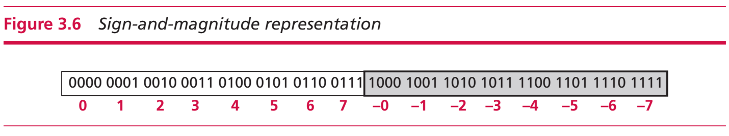
Sign-and-magnitude (giá trị tuyệt đối) representation (biểu diễn)
The leftmost bit defines the sign of the integer.
If it is 0, the integer is positive. If it is 1, the integer is negative.
The range of numbers that can be stored in an n-bit location is -(2^nn-1 -1) to + (2^n -1).

Slide 14
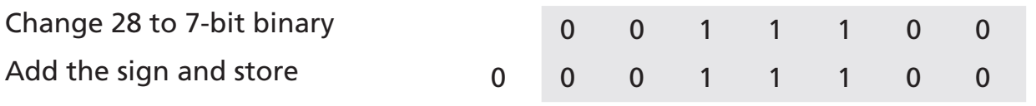
Example
Store +28 in an 8-bit memory location using sign-and-magnitude representation.
Store -28 in an 8-bit memory location using sign-and-magnitude representation.

Slide 15
Example
Retrieve (trích xuất) the integer that is stored as 01001101 in sign-and-magnitude representation.
Since the leftmost bit is 0, the sign is positive. The rest of the bits (1001101) are changed to decimal as 77. After adding the sign, the integer is +77.
Retrieve the integer that is stored as 10100001 in sign-and-magnitude representation.
Since the leftmost bit is 1, the sign is negative. The rest of the bits (0100001) are changed to decimal as 33. After adding the sign, the integer is -33.

Slide 16
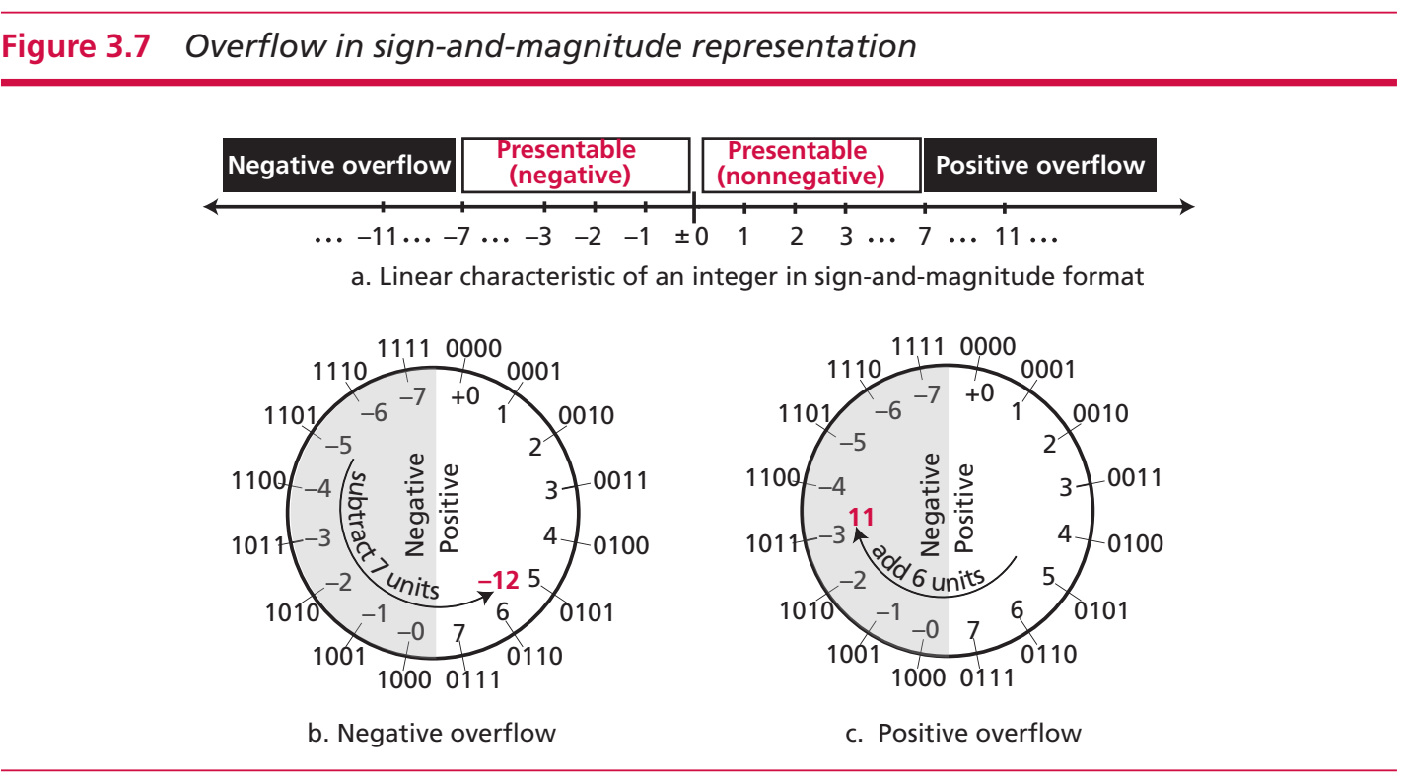
Overflow

Slide 17
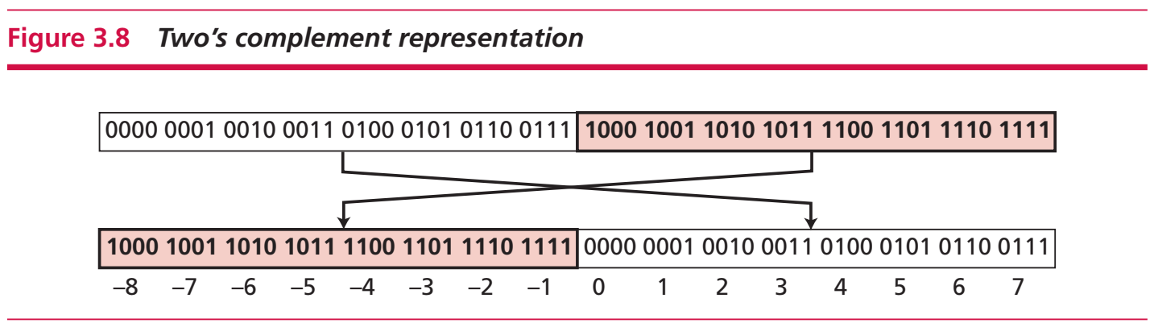
Two’s complement representation
Almost all computers use two’s complement representation to store a signed integer in an n-bit memory location.
The leftmost bit defines the sign of the integer. If it is 0, the integer is positive. If it is 1, the integer is negative.
Notes:
Von Neuman: Von Neuman architecture:
Computers built on the von Neumann model divide the computer hardware into four subsystems: memory, arithmetic logic unit, control unit, and input/output.
Memory
Output data
Memory is the storage area. This is where programs and data are stored during processing. We discuss the reasons for storing programs and data later in the chapter.
Arithmetic logic unit
The arithmetic logic unit (ALU) is where calculation and logical operations take place. For a computer to act as a data processor, it must be able to do arithmetic operations on data (such as adding a list of numbers). It should also be able to do logical operations on data, as we will see in Chapter 4.
Control unit
The control unit controls the operations of the memory, ALU, and the input/output subsystem.
Input / output
The input subsystem accepts input data and the program from outside the computer, while the output subsystem sends the result of processing to the outside world. The definition of the input/output subsystem is very broad: it also includes secondary storage devices such as disk or tape that stores data and programs for processing. When a disk stores data that results from processing, it is considered an output device: when it reads data from the disk, it is considered an input device.

Slide 18
Two’s complement representation
Two operations:
one’s completing - taking the one’s complement of an integer.
This operation simply reverses (flips) each bit. A 0-bit is changed to a 1-bit, a 1-bit is changed to a 0-bit.
two’s completing - taking the two’s complement of an integer.
This operation is done in two steps. First, we copy bits from the right until a 1 is copied, Then, we flip the rest of the bits.
If we apply each operation twice on a number, we will get this integer.
Notes:
Von Neuman: Von Neuman architecture:
Computers built on the von Neumann model divide the computer hardware into four subsystems: memory, arithmetic logic unit, control unit, and input/output.
Memory
Output data
Memory is the storage area. This is where programs and data are stored during processing. We discuss the reasons for storing programs and data later in the chapter.
Arithmetic logic unit
The arithmetic logic unit (ALU) is where calculation and logical operations take place. For a computer to act as a data processor, it must be able to do arithmetic operations on data (such as adding a list of numbers). It should also be able to do logical operations on data, as we will see in Chapter 4.
Control unit
The control unit controls the operations of the memory, ALU, and the input/output subsystem.
Input / output
The input subsystem accepts input data and the program from outside the computer, while the output subsystem sends the result of processing to the outside world. The definition of the input/output subsystem is very broad: it also includes secondary storage devices such as disk or tape that stores data and programs for processing. When a disk stores data that results from processing, it is considered an output device: when it reads data from the disk, it is considered an input device.

Slide 19
Store/Retrieve an integer in two’s complement format
Store:
Change the absolute (giá trị tuyệt đối) value of the integer is to an n-bit binary.
If the integer is positive or zero, it is stored as it is.
If it is negative, the computer takes the two’s complement of the integer and then stores it.
Retrieve:
If the leftmost bit is 1, the computer applies the two’s complement operation to the integer.
If the leftmost bit is 0, no operation is applied.
The computer changes the integer to decimal.

Slide 20
Example
Store the integer 28 in an 8-bit memory location using two’s complement representation.
Positive number, only need to convert and then padding 0 if needed.
Store -28 in an 8-bit memory location using two’s complement representation.
Negative number: convert to binary and then apply two’s complement operation

Slide 21
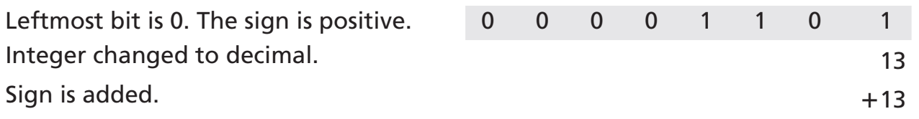
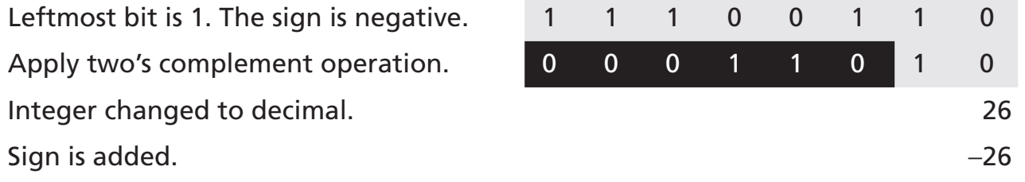
Example
Retrieve the integer that is stored as 00001101 in memory in two’s complement format.
Retrieve the integer that is stored as 11100110 in memory using two’s complement format.

Slide 22
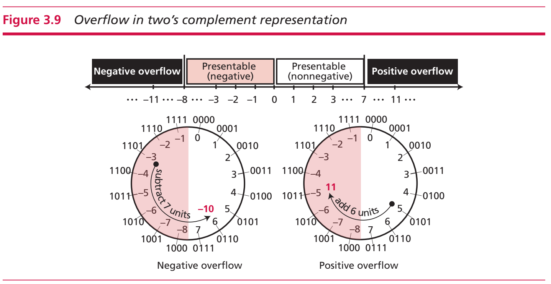
Overflow

Slide 23
Storing reals
Notes:
Các hệ số

Slide 24
Storing reals
A real is a number with an integral part and a fractional part.
Fixed-point representation may not be accurate or it may not have the required precision.
A fixed-point representation with two digits at the right of the decimal point: 1.00234 will be saved as 1.00.
A fixed-point representation with ten digits for the left of the decimal point: 236154302345.00 will be saved as 6154302345.00
Real numbers with very large integral parts or very small fractional parts should not be stored in fixed-point representation.

Slide 25
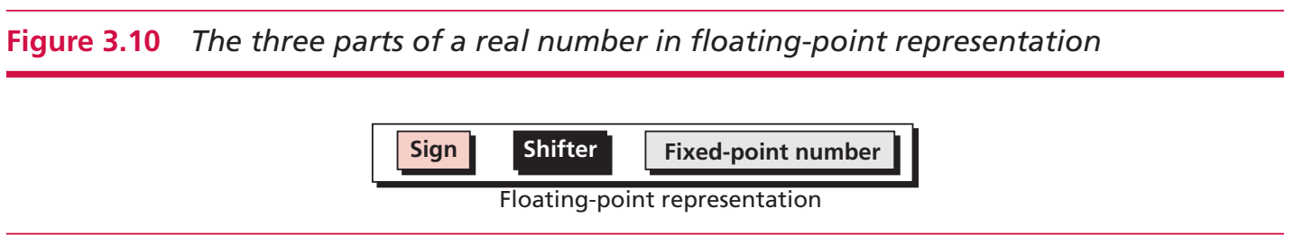
Floating-point representation
Allow the decimal point to float: we can have different numbers of digits to the left or right of the decimal point.
In floating-point representation, a number is made up of three sections.
Floating-point representation is used in science (scientif﻿ic notation) to represent very small or very large.
decimal numbers

Slide 26
Floating-point representation
A number is made up of three sections.
First section: sign, either positive or negative.
Second section: shows how many places the decimal point should be shifted to the right or left to form the actual number
Third section: a fixed-point representation in which the position of the decimal is fixed

Slide 27
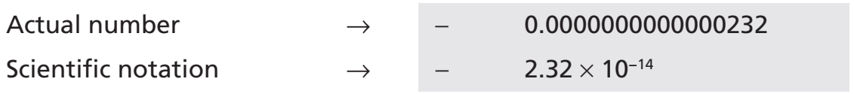
Example
Decimal number 7425000000000000000000.00 in scientific notation.
Decimal number -0.0000000000000232 in scientific notation

Slide 28
Example
Binary number (101001000000000000000000000000000.00) in floating-point format.
Binary number -(0.00000000000000000000000101) in floating-point format

Slide 29
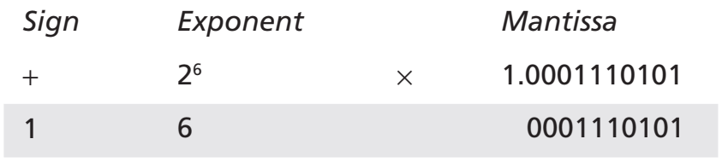
Normalization, sign, exponent, and mantissa
Normalization: Use only one nonzero digit on the left of the decimal point.
3 pieces of information about the number are stored: sign, exponent, and mantissa (the bits to the right of the decimal point)
+1000111.0101 becomes:

Slide 30
Normalization, sign, exponent, and mantissa
Normalization: Use only one nonzero digit on the left of the decimal point.
3 pieces of information about the number are stored: sign, exponent, and mantissa (the bits to the right of the decimal point)
+1000111.0101 becomes:

Slide 31
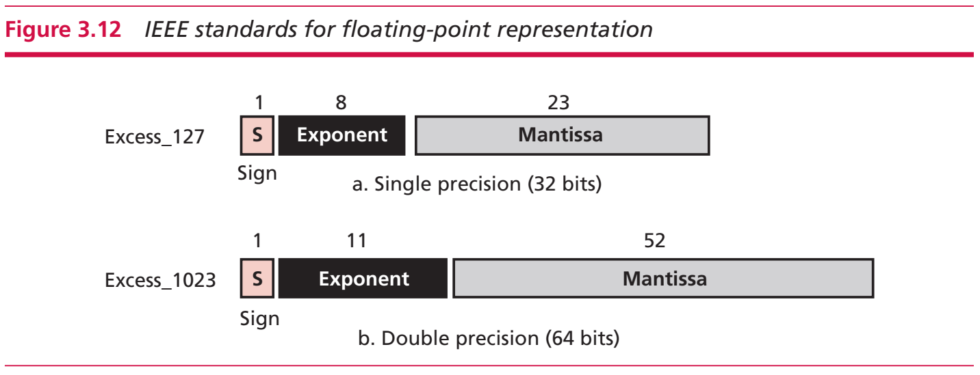
IEEE standards for floating-point representation

Slide 32
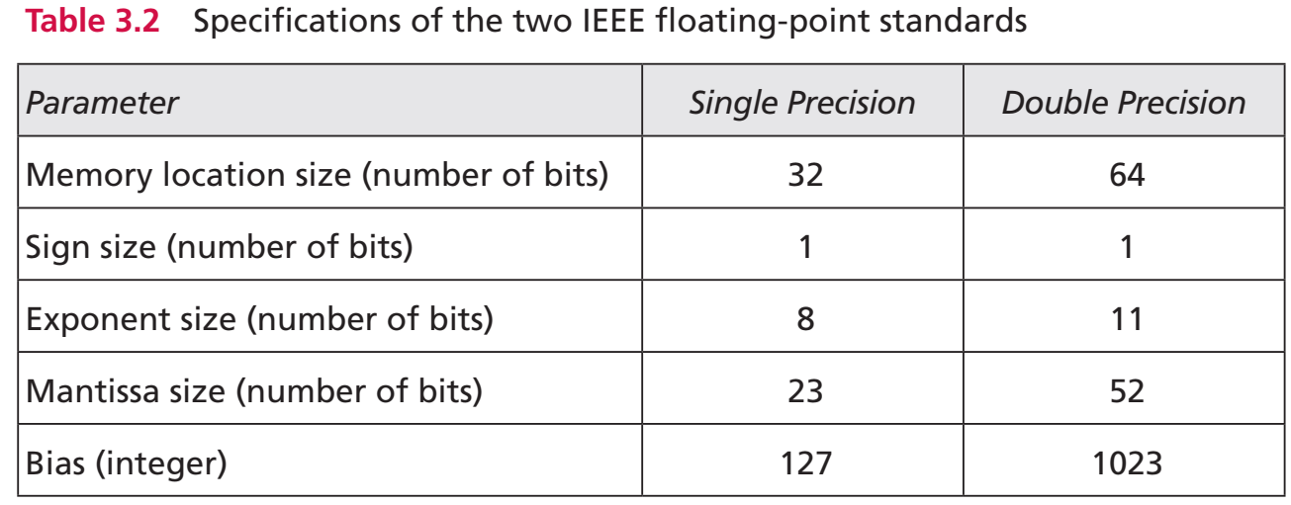
IEEE standards for floating-point representation

Slide 33
Storage of IEEE standard floating-point numbers
Store the sign in S (0 or 1).
Change the number to binary.
Normalize.
Find the values of E and M.
Concatenate S, E, and M.

Slide 34
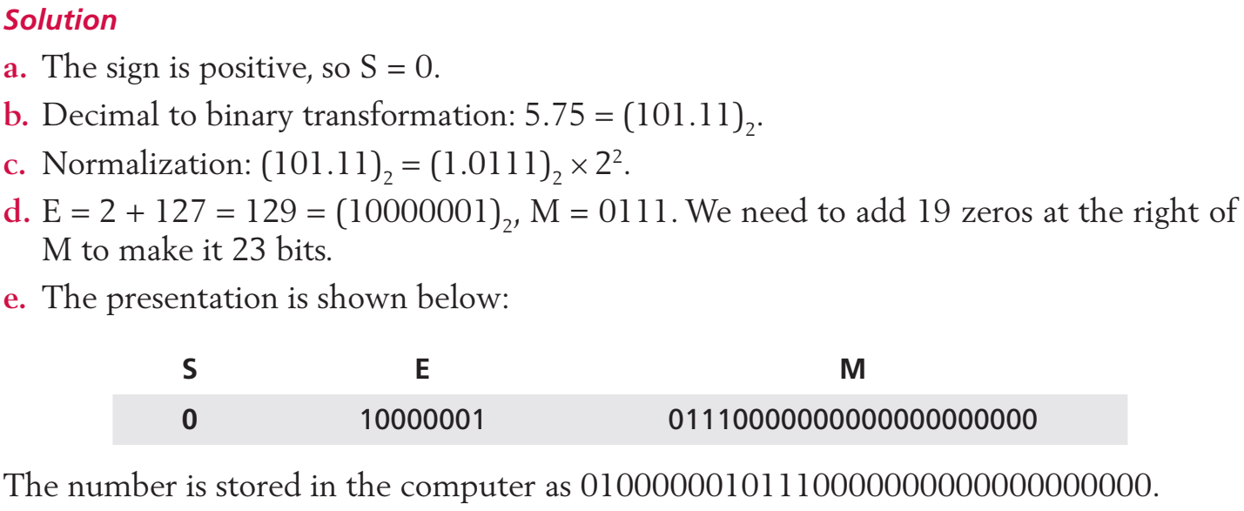
Example
Show the Excess_127 (single precision) representation of the decimal number 5.75.

Slide 35
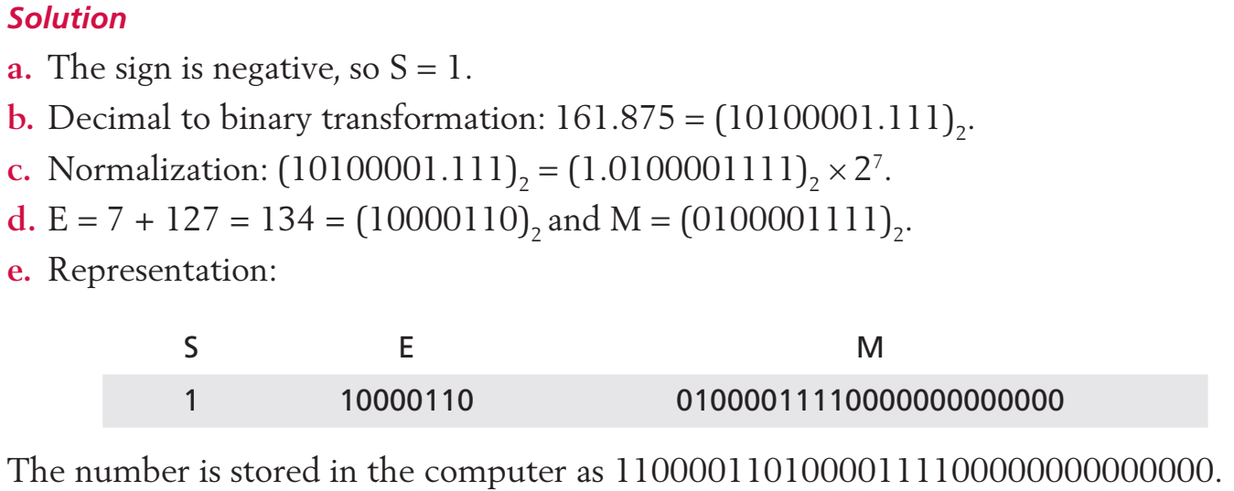
Example
Show the Excess_127 (single precision) representation of the decimal number –161.875

Slide 36
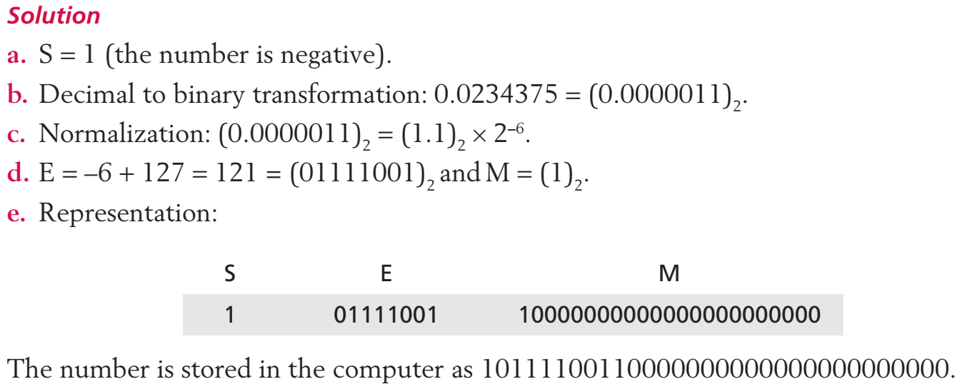
Example
Show the Excess_127 (single precision) representation of the decimal number –0.0234375.

Slide 37
Retrieving numbers stored in IEEE standard floating-point format
Find the value of S, E, and M.
If S = 0, set the sign to positive, otherwise, set the sign to negative.
Find the shifter (E -127).
Denormalize the mantissa.
Change the denormalized number to binary to find the absolute value.
Add the sign.

Slide 38
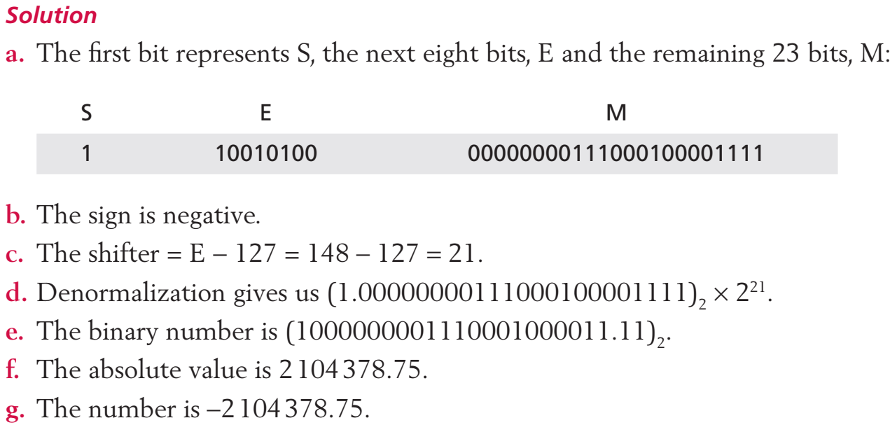
Example
The bit pattern (11001010000000000111000100001111) is stored in memory in Excess_127 format. The value in decimal notation?

Slide 39
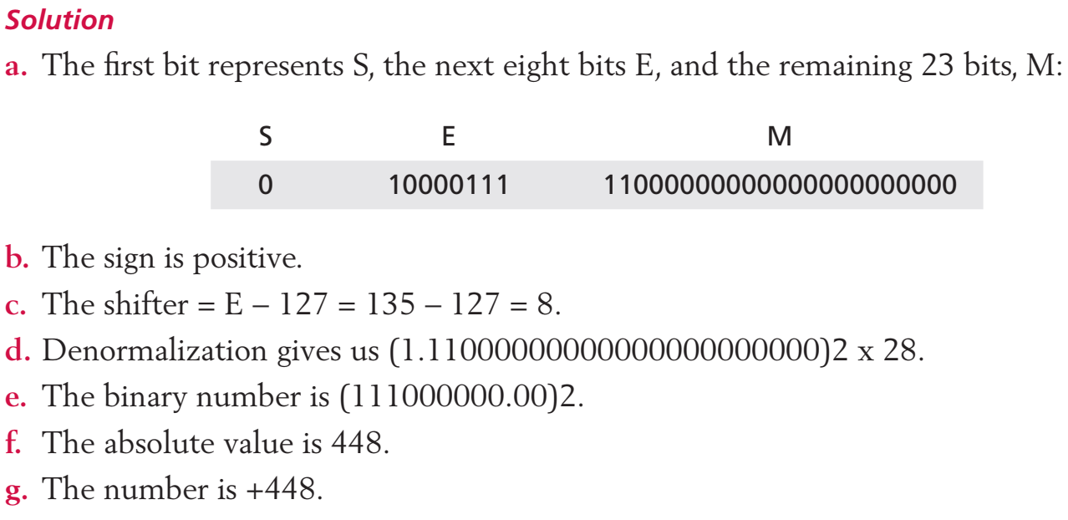
Example
The bit pattern 01000011111000000000000000000000 is stored in memory in Excess_127 format. The value in decimal notation?

Slide 40
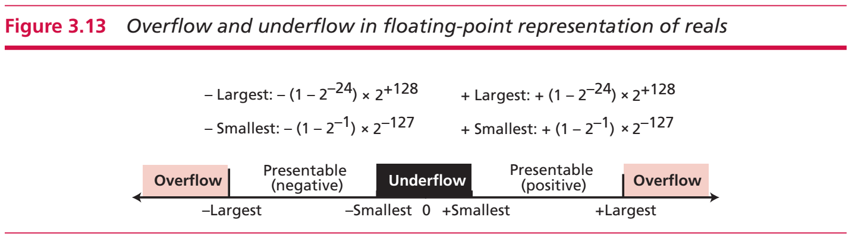
Overflow and underflow

Slide 41
Storing zero/Truncation errors
0: the sign, exponent, and the mantissa are set to 0s.
Truncating errors: When a real number is stored using floating-point representation, the value of the numbered stored may not be exactly as we expect it to be.
It is because the number of real numbers is infinite, while the number of bits to store is bounded

Slide 42
Storing texts/audio/images
Notes:
Các hệ số

Slide 43
STORING TEXT
A section of text in any language is a sequence of symbols used to represent an idea in that language.
English language uses 26 symbols (A, B, C,…, Z) to represent uppercase letters, 26 symbols (a, b, c, …, z) to represent lowercase letters, ten symbols (0, 1, 2, …, 9) to represent numeric characters, and symbols (., ?, :, ; , …, !) to represent punctuation.
Other symbols such as blank, newline, and tab are used for text alignment and readability.

Slide 44
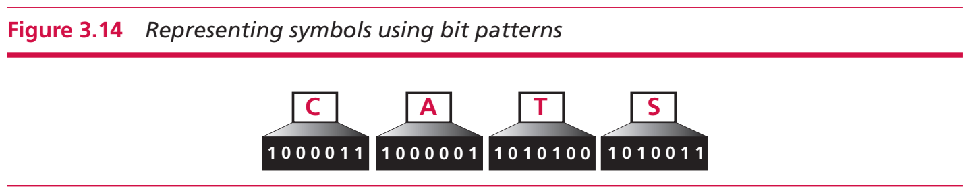
Symbol
We can represent each symbol with a bit pattern.
Text such as ‘CATS’, which is made up from four symbols, can be represented as four n-bit patterns.

Slide 45
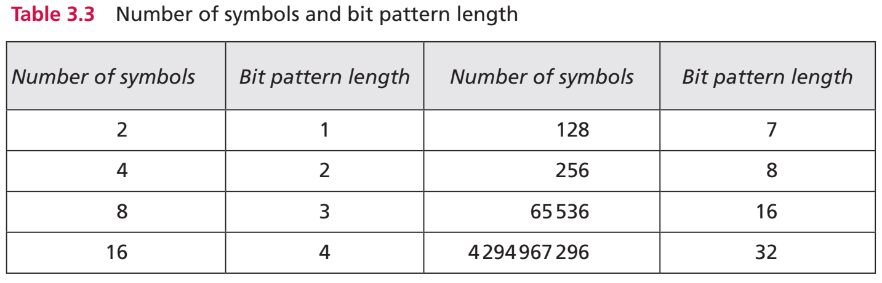
Symbol

Slide 46
Codes
Different sets of bit patterns have been designed to represent text symbols.
Each set is called a code, and the process of representing symbols is called coding.
ASCII - American Standard Code for Information Interchange (ASCII).
This code uses seven bits for each symbol - 128 symbol in total.
Unicode: uses 32 bits and represent up to 2^32 = 4294967296 symbols

Slide 47
Codes
Different sets of bit patterns have been designed to represent text symbols.
Each set is called a code, and the process of representing symbols is called coding.
ASCII - American Standard Code for Information Interchange (ASCII).
This code uses seven bits for each symbol - 128 symbol in total.
Unicode: uses 32 bits and represent up to 2^32 = 4294967296 symbols

Slide 48
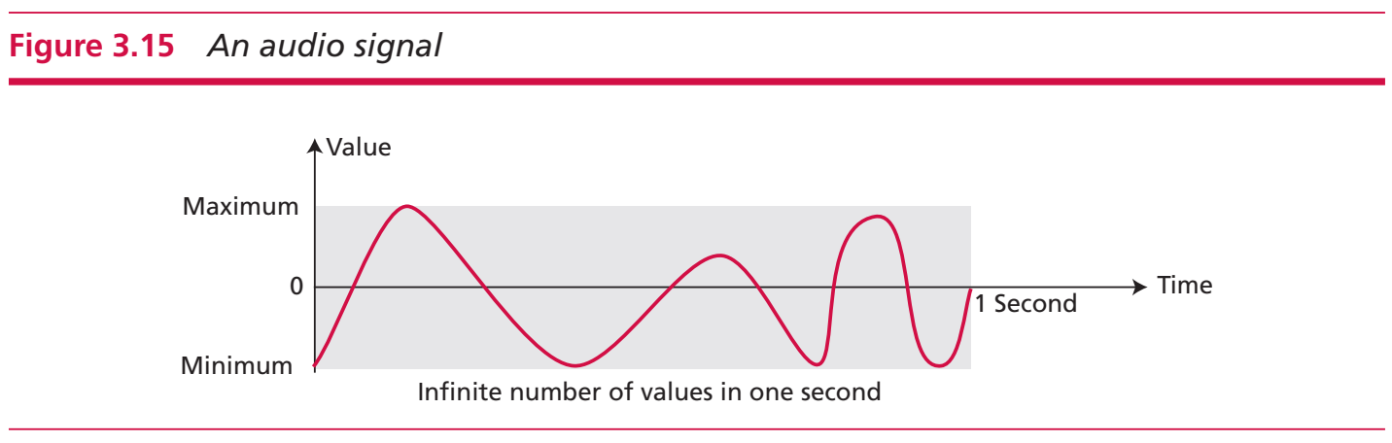
STORING AUDIO
Audio is an entity that changes with time—we can only measure the intensity of the sound at each moment.
Storing audio in computer memory = storing the intensity of an audio signal over a period of time.
Audio is an example of analog data (infinite values)

Slide 49
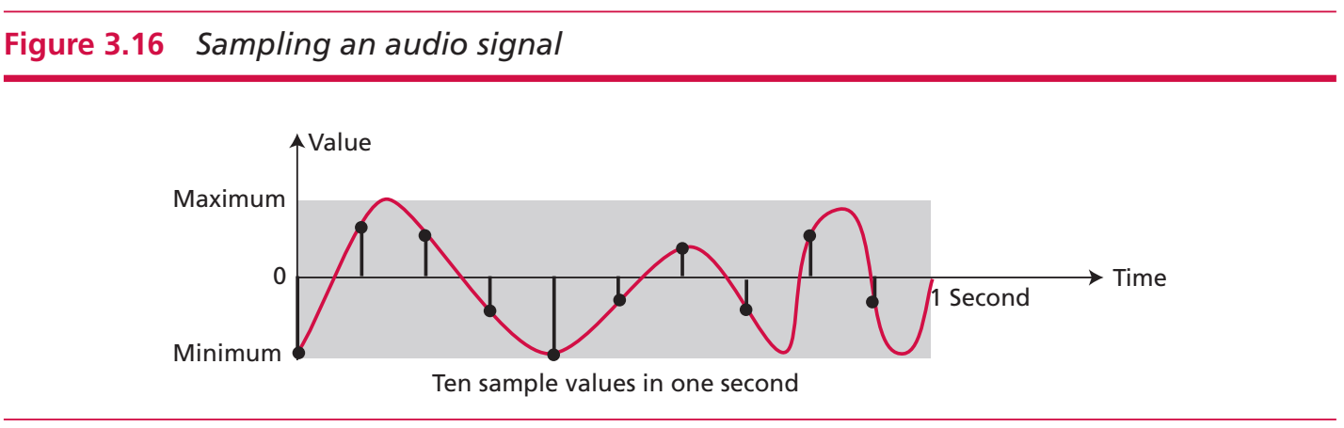
Sampling
Sampling means that we select only a finite number of points on the analog signal, measure their values, and record them.
A sampling rate of 40000 samples per second is good enough to reproduce an audio signal.

Slide 50
Quantization and Encoding
The value measured for each sample is a real number.
Quantization: a process that rounds the value of a sample to the closest integer value
Encoding: quantized sample values need to be encoded as bit patterns.
Bit per sample - bit depth: how many bits should be allocated for each sample (8, 16, 24, 32)>-
Bit rate: bit depth x number of samples per second.
Standards for sound encoding: MP3 - MPEG Layer 3.
44100 samples per second x 16 bits per sample = 705600 bits per second

Slide 51
STORING IMAGES/VIDEO
Images are stored by raster graphics or vector graphics.
Raster graphics (or bitmap graphics): store an analog image such as a photograph using bit pattern.
Standards for image encoding: JPEG (Joint Photographic Experts Group), GIF (Graphic Interchange Format).
Vector graphics
Raster graphics has two disadvantages: the file size is big and rescaling is troublesome.
Vector graphic uses mathematical formulas to draw images.
Video: a representation of images (called frames) over time.
Know how to store an image inside a computer => know how to store video

Slide 52
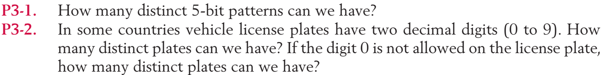
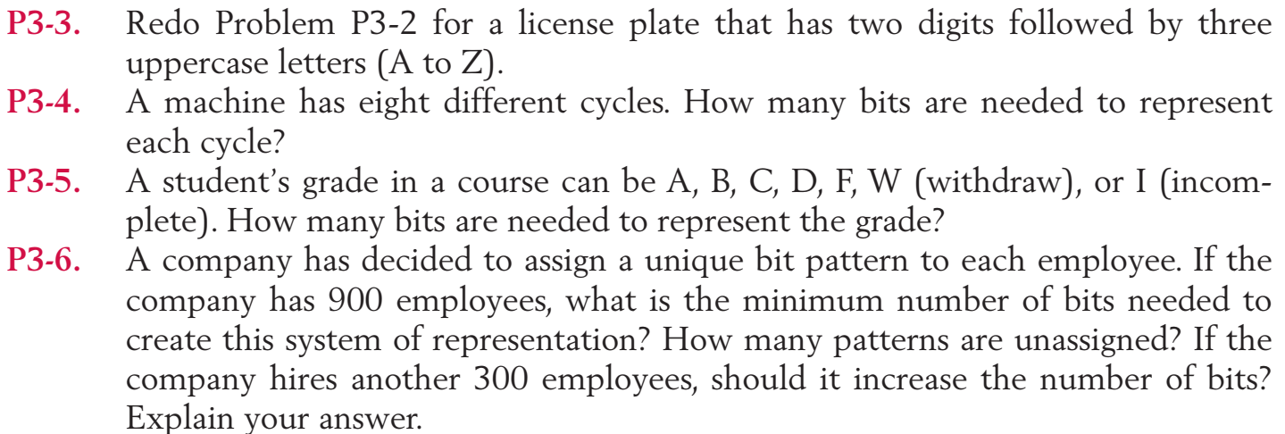
Practice

Slide 53
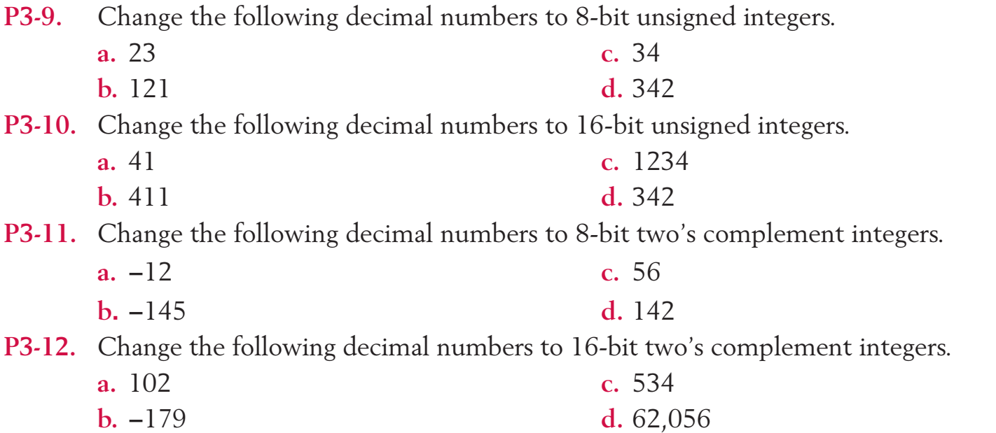
Practice

Slide 54
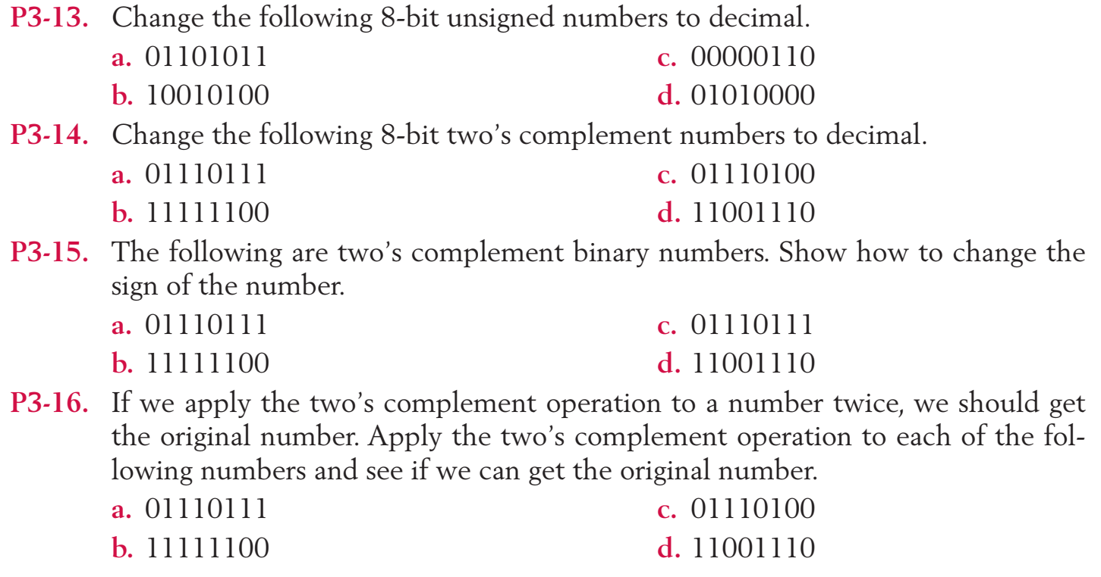
Practice

Slide 55
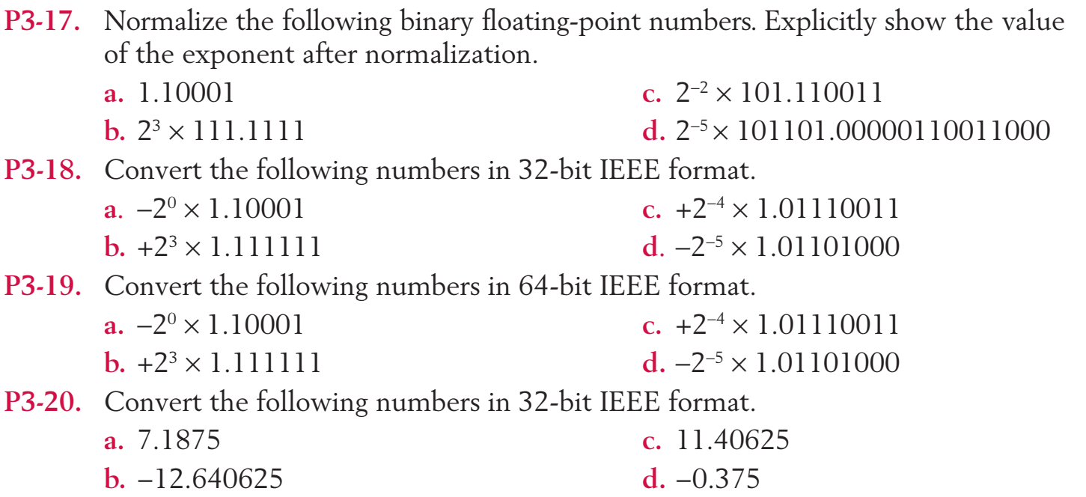
Practice

Slide 56
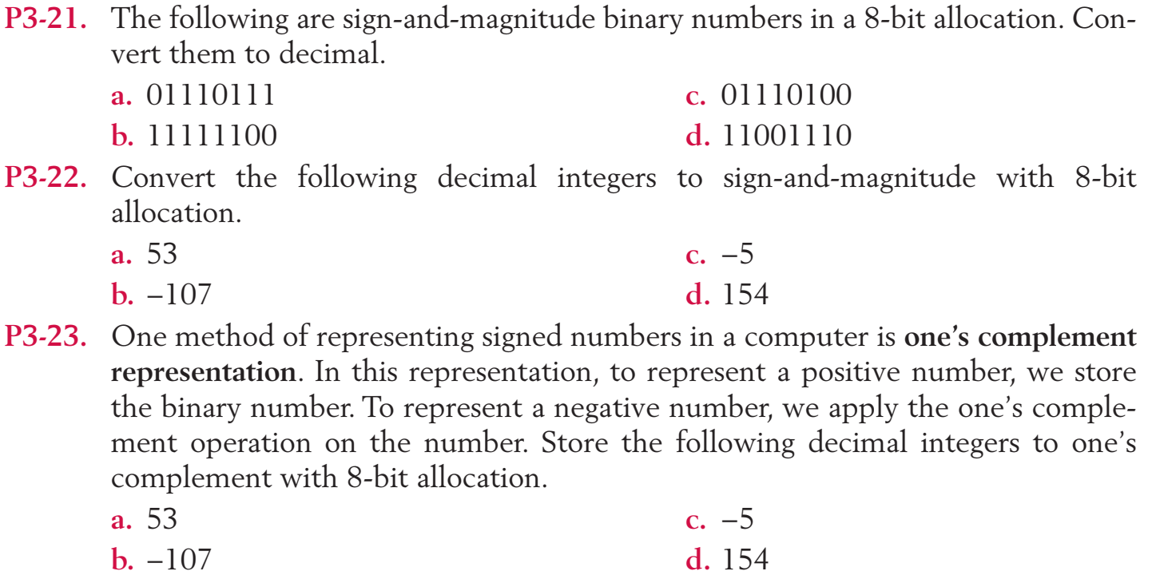
Practice

Slide 57
Q & A

